Slide 1
Classification and Prediction
Unit 6

Slide 2
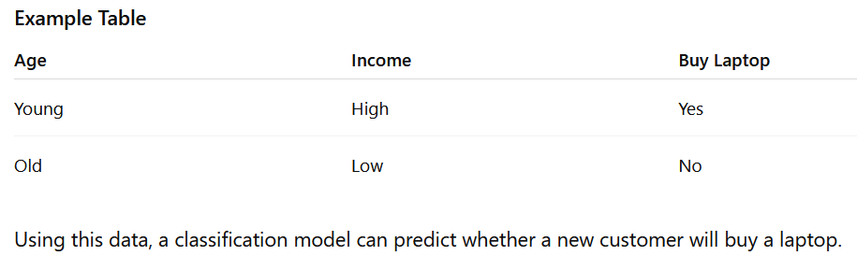
Classification
Classification
Classification is a data mining and machine learning technique used to assign data items into predefined categories or classes based on their attributes.
It predicts categorical values (labels).
A model is trained using labeled data and then used to classify new data.
Examples:
Email → Spam or Not Spam
Student → Pass or Fail
Customer → Buy Product or Not Buy Product

Slide 3
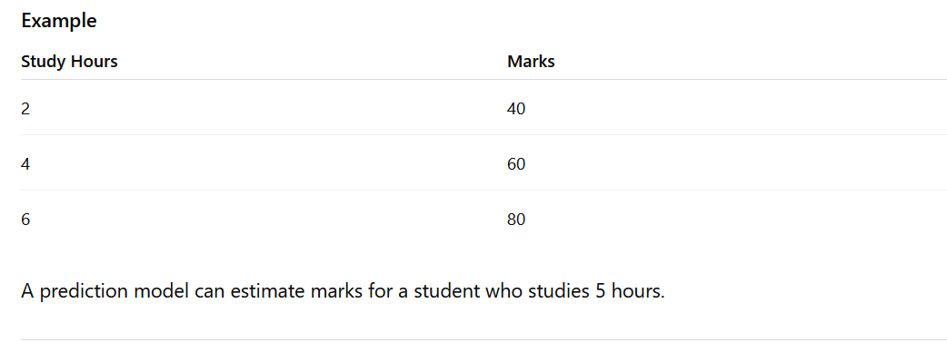
Prediction
Prediction is the process of estimating future or unknown values based on historical data.
It predicts continuous or numeric values.
Uses patterns found in existing data to forecast outcomes.
Examples:
Predicting house prices
Predicting next month's sales
Predicting student marks

Slide 4
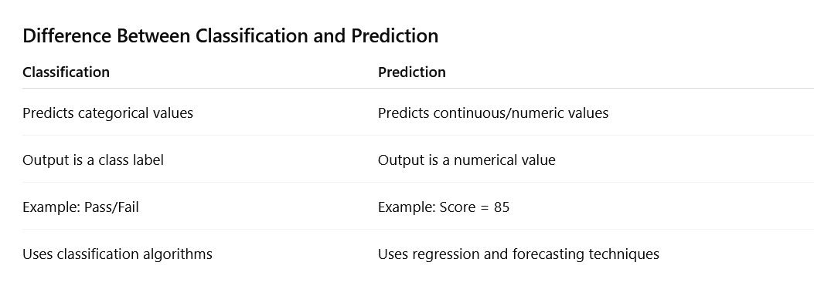

Slide 5
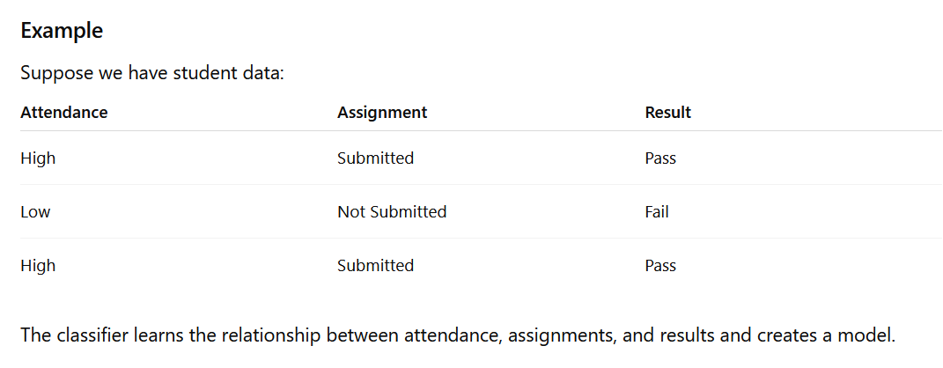
Learning (Training) Phase
The learning phase is the process of building a classification model using a set of training data whose class labels are already known.
Steps in Learning
Collect training data.
Select relevant features (attributes).
Apply a classification algorithm.
Generate a classification model (classifier).
Store the model for future use.
Output
A trained classification model that can classify new, unseen data.

Slide 6
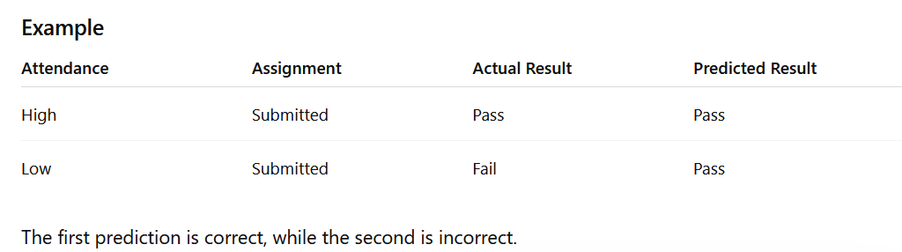
Testing Phase
The testing phase evaluates how accurately the trained classifier predicts the class labels of new data.
Steps in Testing
Use a separate test dataset.
Apply the trained classifier to the test data.
Compare predicted class labels with actual class labels.
Measure performance using accuracy and other metrics.

Slide 7
Real-Life Example
Email Spam Detection
Learning Phase: The system learns from thousands of emails labeled as spam or not spam.
Testing Phase: New emails are checked by the model to determine whether they are spam or not.
Result: Accuracy is measured to evaluate performance.

Slide 8
Classification by Decision Tree Induction, ID3 Algorithm, and Rule-Based Classifier
1. Classification by Decision Tree Induction
A Decision Tree is a tree-like structure used for classification and prediction. It recursively divides the dataset into smaller subsets based on attribute values until a decision can be made.
Components of a Decision Tree
Root Node: Represents the best attribute for splitting the data.
Internal Nodes: Represent tests on attributes.
Branches: Outcomes of the tests.
Leaf Nodes: Final class labels or decisions.

Slide 9
Steps in Decision Tree Induction
Select the best attribute.
Create a root node.
Split the dataset based on attribute values.
Repeat the process for each subset.
Stop when all records belong to the same class or no attributes remain.
Advantages
Easy to understand and interpret.
Handles large datasets.
Requires little data preparation.

Slide 10

2. ID3 (Iterative Dichotomiser 3) as an Attribute Selection Algorithm
ID3 is a popular algorithm developed by Ross Quinlan for constructing decision trees.
Main Idea
ID3 selects the attribute with the highest Information Gain as the splitting attribute.
Entropy
Entropy measures the impurity or uncertainty of data.
Where:
pi​ = probability of class i
Information Gain
Information Gain measures the reduction in entropy after splitting the data.

Slide 11
ID3 Algorithm Steps
Calculate entropy of the dataset.
Compute information gain for each attribute.
Choose the attribute with the highest information gain.
Create a decision node.
Repeat until all records are classified.
Example
Attributes:
Attendance
Assignment
Result (Pass/Fail)
If Attendance has the highest information gain, it becomes the root node.

Slide 12
Rule-Based Classifier
A Rule-Based Classifier uses a set of IF–THEN rules to classify data.
General Form
IF condition THEN class
Example
IF Attendance = High THEN Result = Pass IF Attendance = Low THEN Result = Fail
Advantages
Easy to understand.
Human-readable decision-making.
Useful for expert systems.

Slide 13
Introduction to SVM
Support Vector Machine (SVM) is a supervised machine learning algorithm used for:
Classification
Regression
Outlier detection
Main Goal:
Find the optimal boundary (hyperplane) that separates classes with maximum margin.
Why SVM?
Advantages of SVM:
Effective for high-dimensional data
Works well with small datasets
Prevents overfitting
Can solve linear and nonlinear problems
Good generalization capability

Slide 14
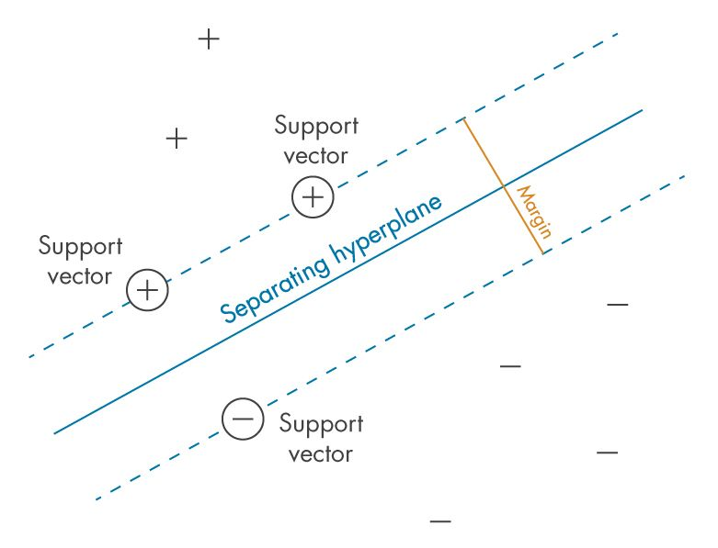
Basic Terminology
Hyperplane
Decision boundary separating classes
Support Vectors
Data points closest to hyperplane
Margin
Distance between support vectors and hyperplane

Slide 15
Working Principle of SVM
Steps:
Input training data
Find possible separating lines
Calculate margin
Select maximum-margin hyperplane
Classify new data points
Mathematical Representation
Hyperplane equation: w.x+b=0
Where:
w = weight vector
x = input feature vector
b = bias
Decision function:
f(x)=sign(w.x+b)

Slide 16
Linear SVM
Used when data is linearly separable.
Characteristics:
Straight decision boundary
Faster training
Simple implementation
Example:
Email Spam Classification
Nonlinear SVM
Used when data cannot be separated by a straight line.
Solution: Kernel Trick
Types of kernels:
Linear Kernel
Polynomial Kernel
Radial Basis Function (RBF)
Sigmoid Kernel

Slide 17
Applications of SVM
Applications:
Image recognition
Face detection
Handwriting recognition
Medical diagnosis
Spam filtering
Text classification
Bioinformatics
Advantages
✓ High accuracy ✓ Works with high-dimensional data ✓ Memory efficient ✓ Effective for complex datasets
Disadvantages
✗ Slow on large datasets ✗ Difficult parameter tuning ✗ Less effective with noisy data

Slide 18
Evaluation Metrics in Machine Learning
Evaluation metrics are used to measure how well a machine learning model performs.
They help assess whether the model is making accurate predictions and meeting the desired goals.
Model Performance : Measures how well the model works
Different Tasks : Used for classification, regression and clustering
Right Metric Choice : Helps select the best way to evaluate a model
Better Decisions : Ensures the model meets its objectives

Slide 19

Classification Metrics
1. Accuracy
Accuracy is a fundamental metric used for evaluating the performance of a classification model.
It tells us the proportion of correct predictions made by the model out of all predictions.

Slide 20
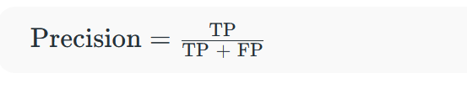
2. Precision
It measures how many of the positive predictions made by the model are actually correct.
It's useful when the cost of false positives is high such as in medical diagnoses where predicting a disease when it’s not present can have serious consequences.
Where:
TP = True Positives
FP = False Positives
Precision helps ensure that when the model predicts a positive outcome, it’s likely to be correct.

Slide 21
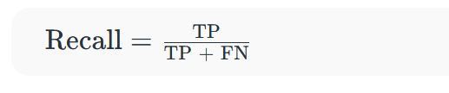
3. Recall
Recall or Sensitivity measures how many of the actual positive cases were correctly identified by the model.
It is important when missing a positive case (false negative) is more costly than false positives.
Where:
FN = False Negatives
In scenarios where catching all positive cases is important (like disease detection), recall is a key metric.

Slide 22

4. F1 Score
The F1 Score is the harmonic mean of precision and recall.
It is useful when we need a balance between precision and recall as it combines both into a single number.
A high F1 score means the model performs well on both metrics. Its range is [0,1].
Lower recall and higher precision gives us great accuracy but then it misses a large number of instances.
More the F1 score better will be performance.
It can be expressed mathematically in this way:

Slide 23
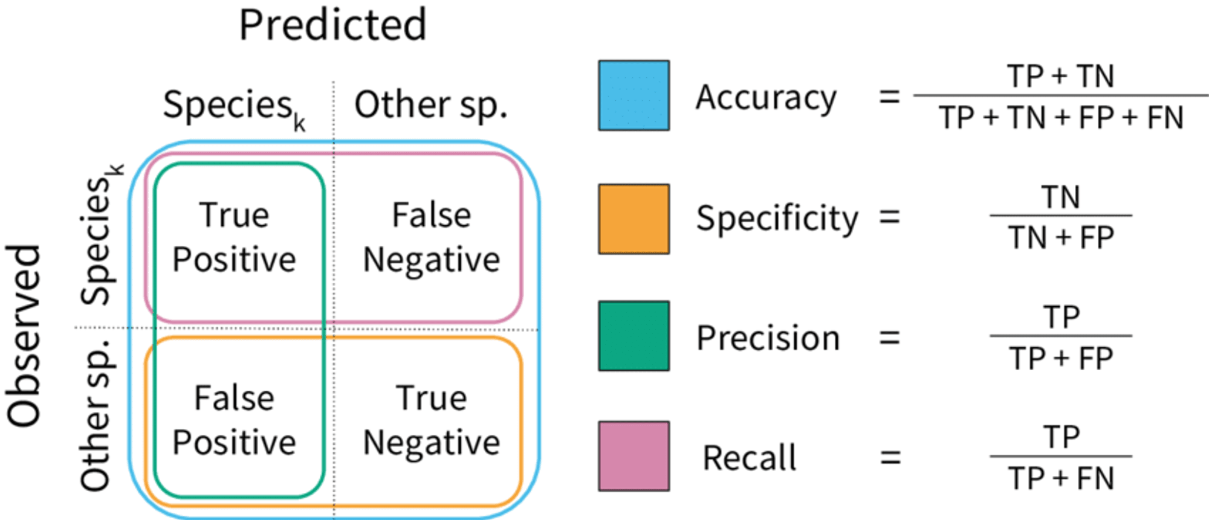

Slide 24
Classification Issues in Machine Learning
Classification models may not always perform well due to learning problems such as:
Overfitting
Underfitting
Data imbalance
Noise in data
Insufficient training data
These issues reduce prediction accuracy and model performance.
What is Overfitting?
Overfitting occurs when a model learns the training data too well, including noise and unnecessary details.
Characteristics:
Very high training accuracy
Low testing accuracy
Poor generalization on new data
Example:
A student memorizes answers instead of understanding concepts.

Slide 25
Causes of Overfitting
Main causes:
Small training dataset
Excessive model complexity
Too many features
Training for too many iterations
Presence of noise in data
Problems Caused by Overfitting
Effects:
Poor prediction on unseen data
Increased variance
Reduced model reliability
High computational cost

Slide 26
What is Underfitting?
Underfitting occurs when a model cannot capture patterns from training data.
Characteristics:
Low training accuracy
Low testing accuracy
Poor learning capability
Example:
A student studies too little and cannot understand concepts.
Causes of Underfitting
Main causes:
Very simple model
Insufficient training time
Too few features
Excessive regularization

Slide 27
K-fold cross validation,
K-Fold Cross Validation is a model evaluation technique used in machine learning to assess the performance of a model.
Purpose:
Evaluate model reliability
Reduce overfitting
Improve prediction accuracy
Use data efficiently
Why Use K-Fold Cross Validation?
Problems with simple train-test split:
Results may depend on random data selection
Some data may not be used effectively
Performance estimation may be inaccurate
K-Fold solves these problems by using all data for training and testing.

Slide 28
Basic Working Principle
Steps:
Divide dataset into K equal subsets (folds)
Select one fold as testing data
Use remaining folds for training
Train and evaluate the model
Repeat until all folds are used once as testing data
Calculate average performance
Advantages
✓ Better use of data ✓ Reduces overfitting ✓ More reliable evaluation ✓ Lower bias ✓ Suitable for small datasets

Slide 29
Disadvantages
Computationally expensive
Requires repeated model training
Slow for large datasets
Applications
Applications of K-Fold Cross Validation:
Classification problems
Regression models
Medical prediction systems
Image recognition
Fraud detection
Machine learning model selection

